Slide 1

CROWDFUNDING
KICKSTARTER DATA ANALYSIS
GROUP 2
SUYASH MADALE
SHAIK ABUBAKAR
SHUBHAM MANDHARE
RUTUJA YELGATTE
VINAY D R

Slide 2
INDEX
TABLE OF CONTENT
Data Overview
4
Recommendations
1
FOR CREATOR
FOR BACKERS
FOR KICKSTARTER
2
Performance Analysis
OVERALL DATASET
SUCCESSFUL PROJECTS
PERCENTAGE OF SUCCESFUL PROJECTS
5
Challenges Faced
3
Key Insights/Observations
6
Conclusion

Slide 3
DATA OVERVIEW
1
THE DATASET COVERS KICKSTARTER PROJECTS ACROSS MULTIPLE YEARS.
2
DETAILS ON FUNDING GOAL, AMOUNT RAISED, DURATION, AND OUTCOME.
3
DATES WERE ORIGINALLY IN EPOCH FORMAT AND CONVERTED TO STANDARD CALENDAR FORMAT.
4
ENGAGEMENT DATA, SUCH AS NUMBER OF BACKERS, IS AVAILABLE.
5
ALL FINANCIAL VALUES WERE CONVERTED TO USD USING A STATIC EXCHANGE RATE.
6
THE DATA REQUIRED CLEANING AND NORMALIZATION TO HANDLE MISSING VALUES

Slide 4




DATA OVERVIEW
Total Projects
Total Locations
365.9K
22.02K
Total Categories
Total Creators
169
303.3K

Slide 5
PERFORMANCE ANALYSIS
TOTAL NO. OF PROJECTS BASED ON OUTCOME

Slide 6
PERFORMANCE ANALYSIS
TOTAL NO. OF PROJECTS BASED ON LOCATIONS
Los Angeles, New York, London, Chicago etc secures Highest no of projects.
Cities in the list are highly metropolitan and plays key role in Entertainment, Tech and Start-up sectors

Slide 7
PERFORMANCE ANALYSIS
TOTAL NO. OF PROJECTS BASED ON CATEGORY

Slide 8
PERFORMANCE ANALYSIS
TOTAL NO. OF PROJECTS BASED ON CATEGORY

Slide 9
PERFORMANCE ANALYSIS
TOTAL NO. OF PROJECT BY YEAR
Massive growth between 2012–2015, followed by a slowdown,
2014 records highest no. of project created on the platform

Slide 10
PERFORMANCE ANALYSIS
TOTAL NO. OF PROJECT BY MONTH
Highest Project count
July
March
May
Least Project count:
December
November

Slide 11
PERFORMANCE ANALYSIS
TOTAL NO. OF PROJECT BY QUARTER
Q3 (July–Sept) is the most active quarter.
Drop observed during Q4

Slide 12



PERFORMANCE ANALYSIS
SUCCESSFUL PROJECTS’ PERFORMANCE
39.97M
No. of Backers
1.35B
80.4
Amount Raised
Avg No. of Days

Slide 13
PERFORMANCE ANALYSIS
TOP SUCCESSFUL PROJECTS BASED ON NO. OF BACKERS
TABLETOP GAMES
Exploding Kittens
Bears vs Babies
PRODUCT DESIGN
Fidget Cube
Pebble Time
VIDEO GAMES
Double Fine Adventure
Torment
Project Eternity
Yooka-Laylee

Slide 14
PERFORMANCE ANALYSIS
TOP SUCCESSFUL PROJECTS BASED ON AMOUNT RAISED
VIDEO GAMES
Elite: Dangerous
Shenmue 3
Camelot Unchained
The Bards Tale IV
Obduction
NARRATIVE FILMS
Wish I was here
The Veronica Mars movie
Blue Mountain State
The Newest Hottest Spike Lee Joint

Slide 15
PERFORMANCE ANALYSIS
PERCENTAGE OF SUCCESSFUL PROJECTS BY GOAL RANGE
Stable Yearly Efficiency
Short-Distance Flights Dominate
1
4
Overall Stable across years. Indicates consistent demand & operational balance
Over 80% of flights are < 1000 miles. Implies a regional hub-based model
0-5000 Alone comprises ~ 60%
0-10000 comprises ~ 78%
1000-20000 comprises ~ 67%
Seasonality Impacts Load Factor
Weekday Travel Dominates
2
5
Heavy summer travel demand and off-peak challenges in winter.
71% of passengers prefer weekdays, highlighting business travel behavior over leisure-based weekend travel.
Uneven Load Factor Efficiency
3
6
Uneven Route Demand
Delta and Southwest alone make-up around 39%. while Comair and ExpressJet show underperformance
Heavy dependence on a few routes and a few carriers risks operational resilience if those face disruption.

Slide 16
PERFORMANCE ANALYSIS
PERCENTAGE OF SUCCESSFUL PROJECTS BY CATEGORY
Stable Yearly Efficiency
Short-Distance Flights Dominate
1
4
Overall Stable across years. Indicates consistent demand & operational balance
Over 80% of flights are < 1000 miles. Implies a regional hub-based model
Tabletop Games leads with 17.43% share followed by Product Design and Music with 16.66% and 14.29% respectively.
Seasonality Impacts Load Factor
Weekday Travel Dominates
2
5
Heavy summer travel demand and off-peak challenges in winter.
71% of passengers prefer weekdays, highlighting business travel behavior over leisure-based weekend travel.
Uneven Load Factor Efficiency
3
6
Uneven Route Demand
Delta and Southwest alone make-up around 39%. while Comair and ExpressJet show underperformance
Heavy dependence on a few routes and a few carriers risks operational resilience if those face disruption.

Slide 17
KEY RECOMMENDATIONS
FOR CREATORS
KEY INSIGHTS
SUMMARY OF ANALYTICAL RESULTS
High failure rate
Global reach is limited
1
4
Over 50% of projects fail,
about 38% succeed,
indicating the need for better planning.
Most users are based in the US, mainly in major metro and business hubs.
Decline in project count post 2015
Entertainment & Creativity genre Dominates
2
5
Project counts peaked in 2014–2015 but declined in later years,.
Most highly funded projects (>$2M) are from Entertainment or creative genre
Seasonality impacts conversion
Optimal goal setting for success
3
6
Most project launches occur in Q2 and Q3, while December has the lowest activity.
Projects with realistic targets have higher chance of successful conversion. Optimal duration is 70-100 days

Slide 18
KEY RECOMMENDATIONS
FOR CREATORS
Launch in Peak Months
Optimize Campaign Duration
Target Q2-Q3 for maximum exposure.
Keep campaigns around 70-100 days to maintain backer interest successfully.
Stable Yearly Efficiency
Short-Distance Flights Dominate
1
4
Overall Stable across years. Indicates consistent demand & operational balance
Over 80% of flights are < 1000 miles. Implies a regional hub-based model
Seasonality Impacts Load Factor
Weekday Travel Dominates
2
5
Heavy summer travel demand and off-peak challenges in winter.
71% of passengers prefer weekdays, highlighting business travel behavior over leisure-based weekend travel.
Uneven Load Factor Efficiency
3
6
Uneven Route Demand
Delta and Southwest alone make-up around 39%. while Comair and ExpressJet show underperformance
Heavy dependence on a few routes and a few carriers risks operational resilience if those face disruption.
Set Realistic Funding Goals
Engage with Your Community
Pre-launch marketing
Set Lower-Mid goals to gather more no. of backers
Low: 0-5000$
Mid: 5000-20000$
Regularly update backers, respond to comments, and build trust.
Start marketing early to generate buzz and secure initial backers on Day 1.

Slide 19
KEY RECOMMENDATIONS
FOR BACKERS
1
4
Diversify Support Across Categories
Engage with the creator
Support both big and small creators
consider creative arts, not just tech/games.
Comment, share, and ask questions
Take regular updates from the creators
Support in Peak Periods
2
3
Support Early to build Momentum
Explore Kickstarter actively during Q2–Q3, when many quality campaigns go live.
Early backers help projects gain visibility and social proof, increasing the chance of success.

Slide 20
KEY RECOMMENDATIONS
FOR KICKSTARTER
1
IMPROVE CREATOR ONBOARDING
Offer training, tutorials, and checklists to help creators plan better campaigns.
2
HIGHLIGHT HIGH-POTENTIAL NEW CATEGORIES
Promote underrepresented but promising fields like Theatre, Art, and Documentary.
3
CREATE GEO-TARGETED CAMPAIGN PROMOTIONS
Promote campaigns from non-urban or underrepresented areas to widen reach.
4
REWARD ENGAGED BACKERS
Provide badges, recognition, offers
for long-term and high-activity users
5
LAUNCH MONTHLY CREATOR SPOTLIGHTS
Feature upcoming talent or innovative ideas on the homepage and social media..
6
ENHANCE CAMPAIGN DISCOVERY TOOLS
Use smart algorithms to match backers with projects they’re likely to support.

Slide 21
CHALLENGES FACED
1
INCONSISTENT DATA ENTRIES
2
GOAL RANGE BINNING
3
LARGE DATASET SIZE
4
SYSTEM FAILURE

Slide 22
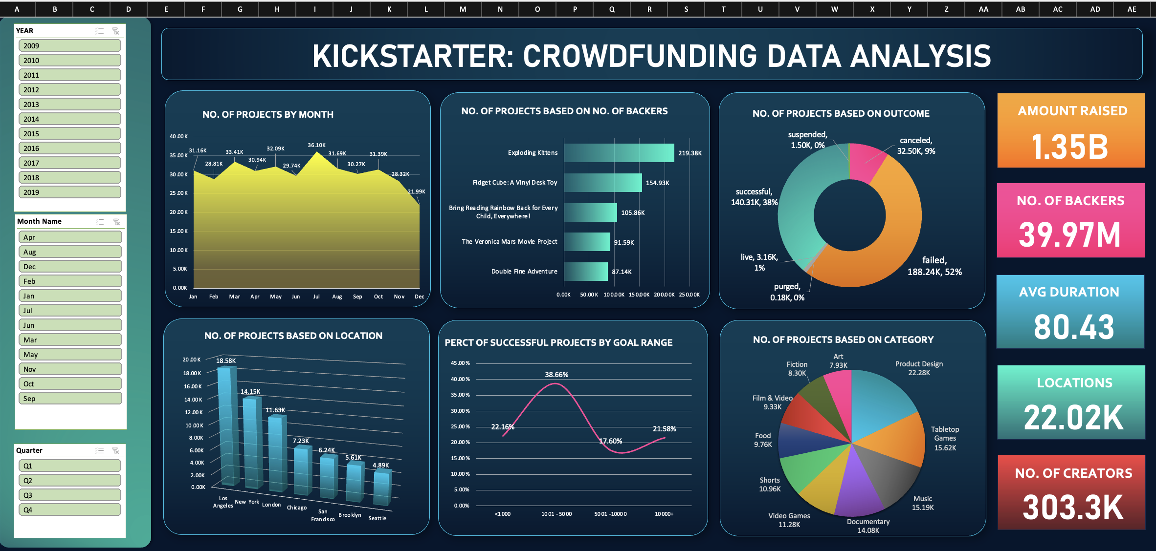
EXCEL DASHBOARD

Slide 23
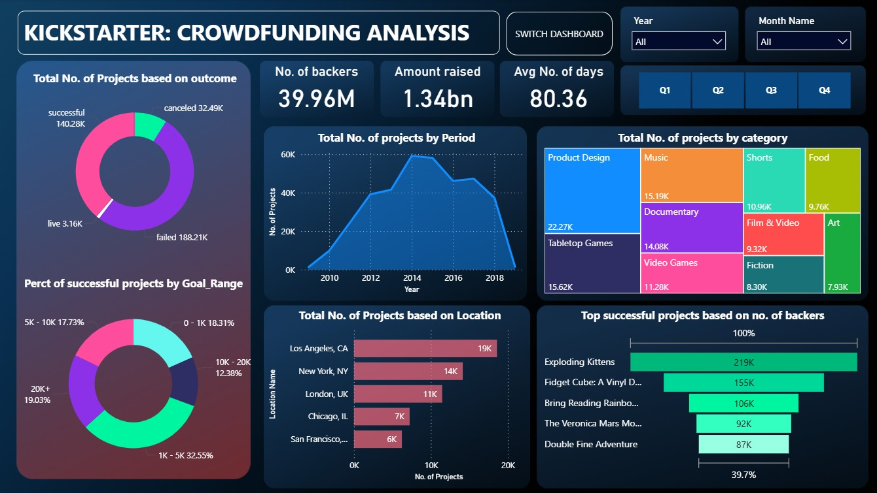
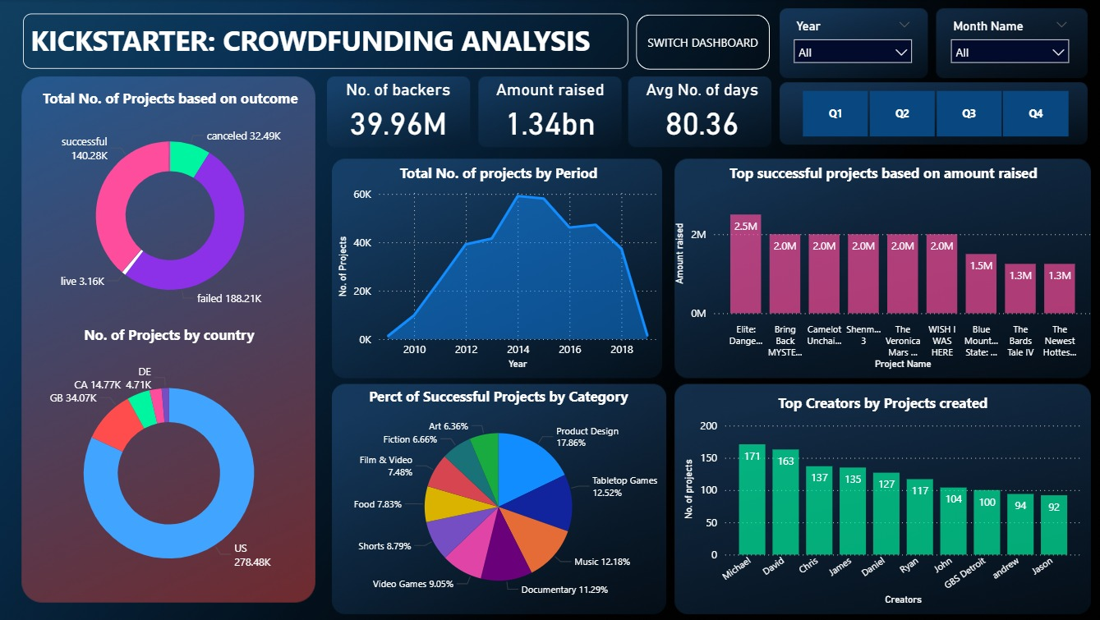
POWERBI DASHBOARD

Slide 24
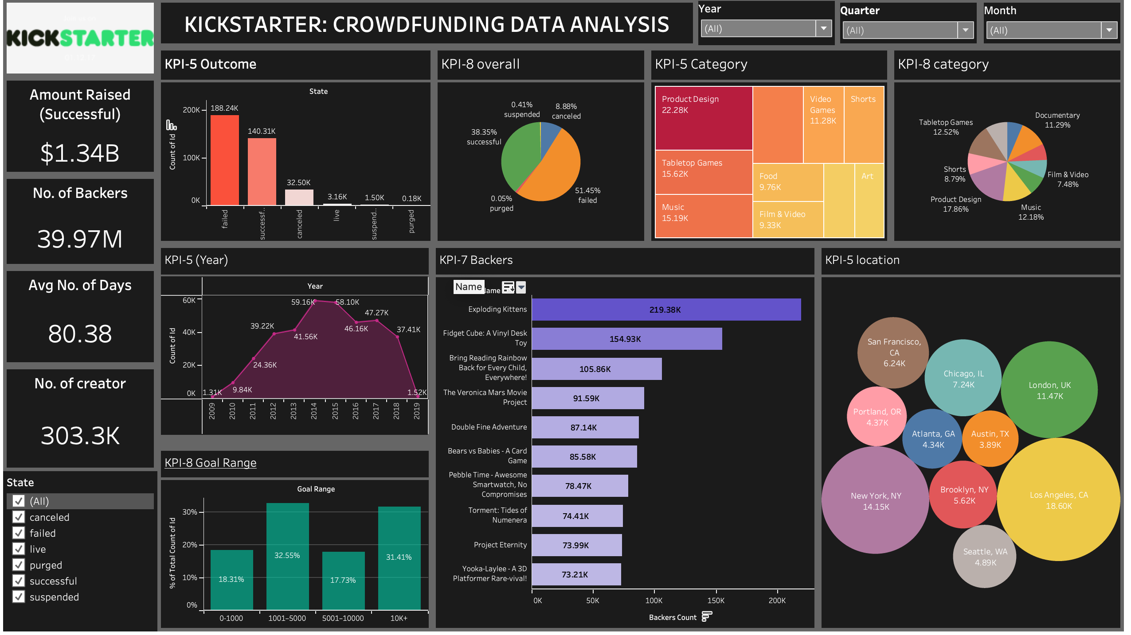
TABLEAU DASHBOARD

Slide 25
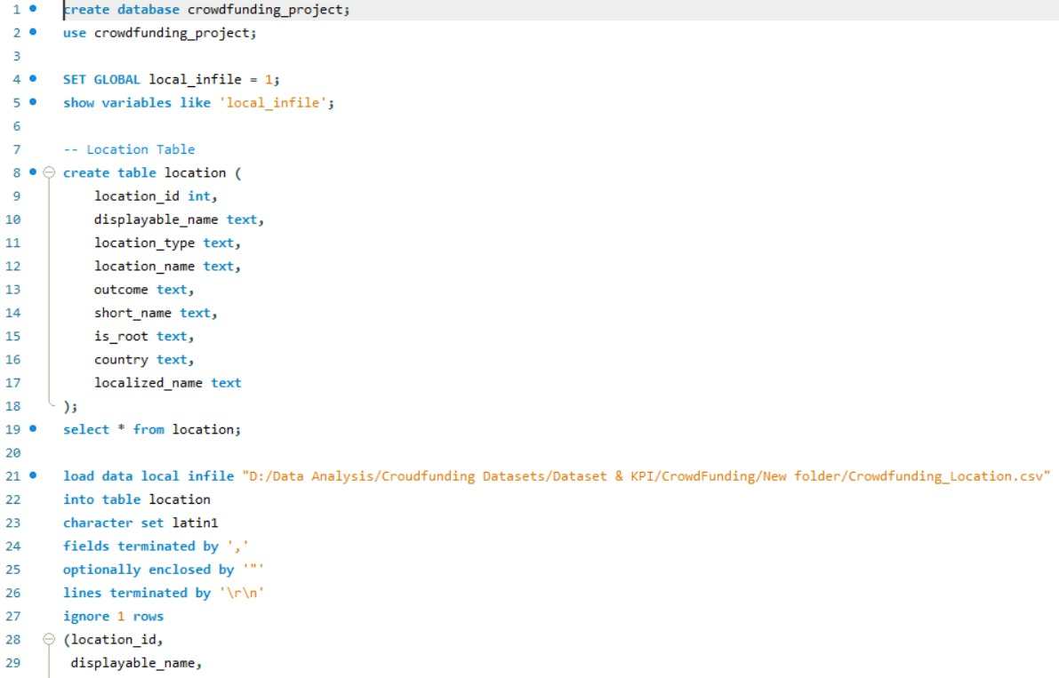
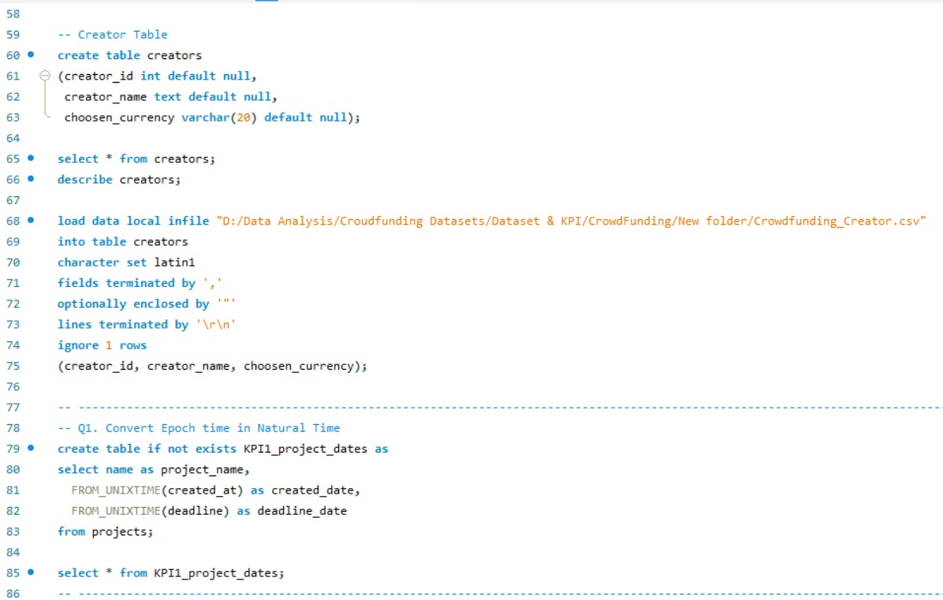
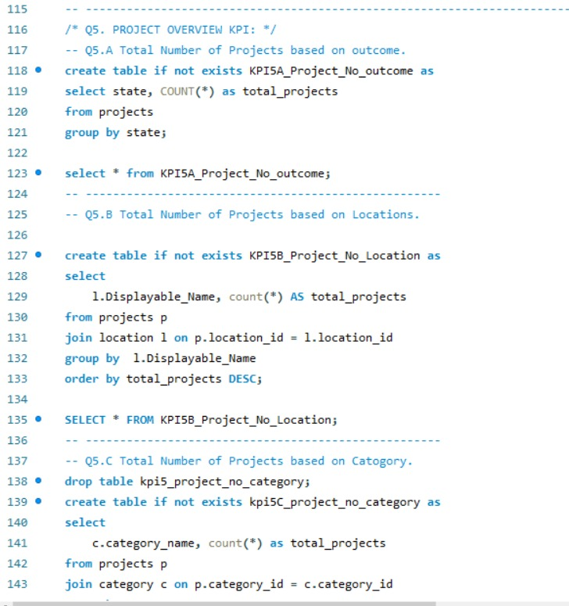
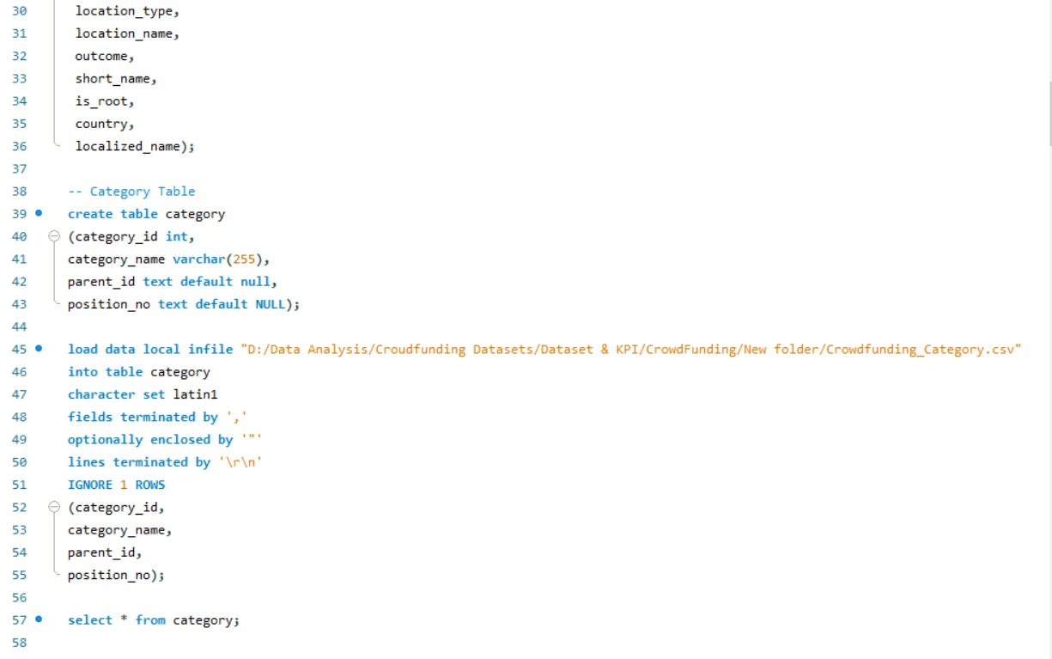
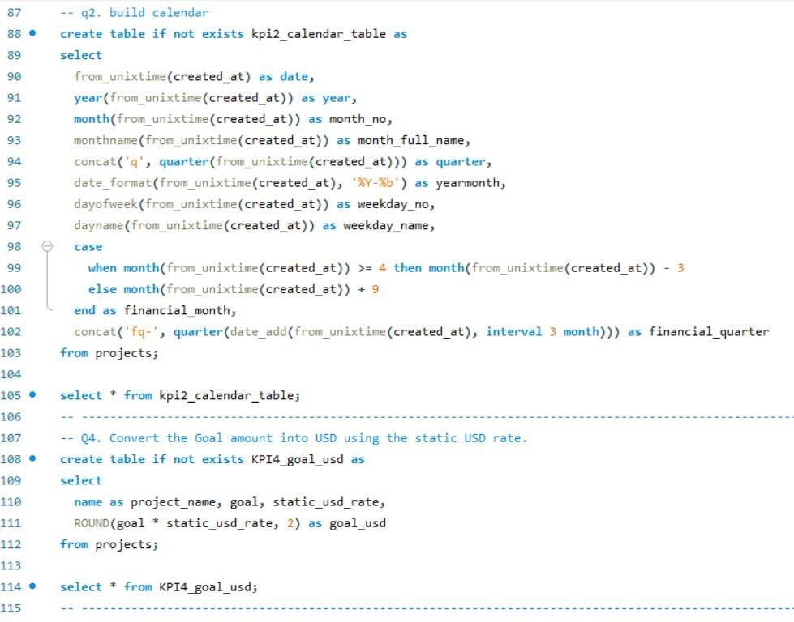
SQL QUERIES

Slide 26
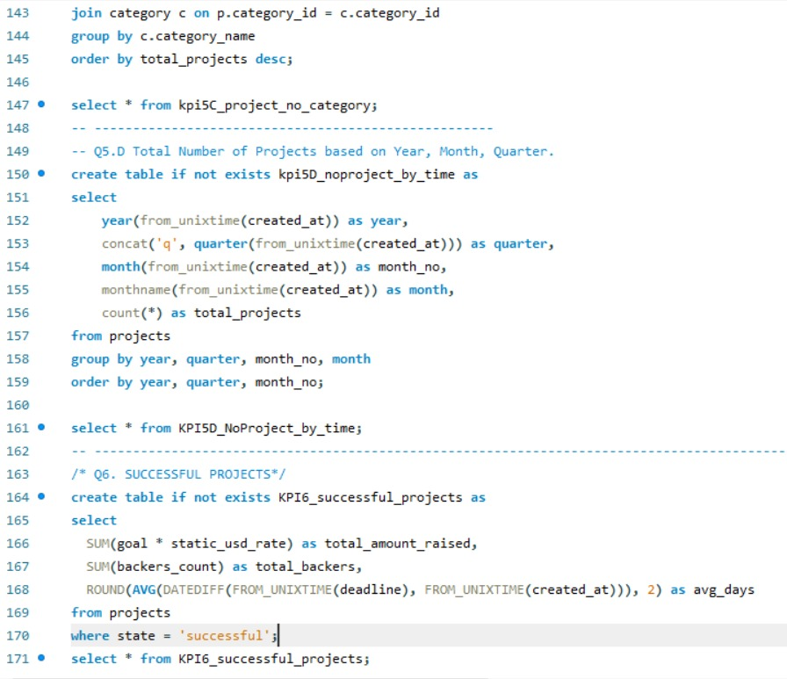
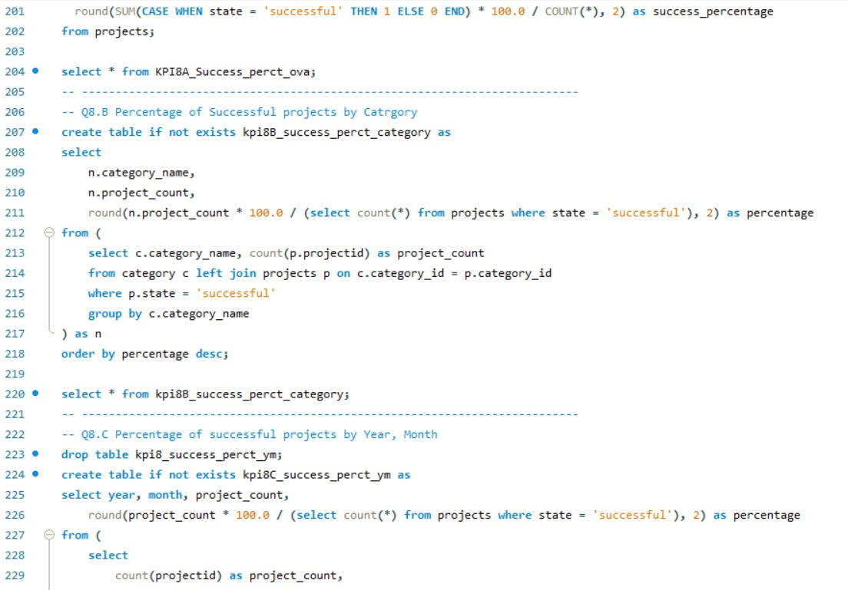
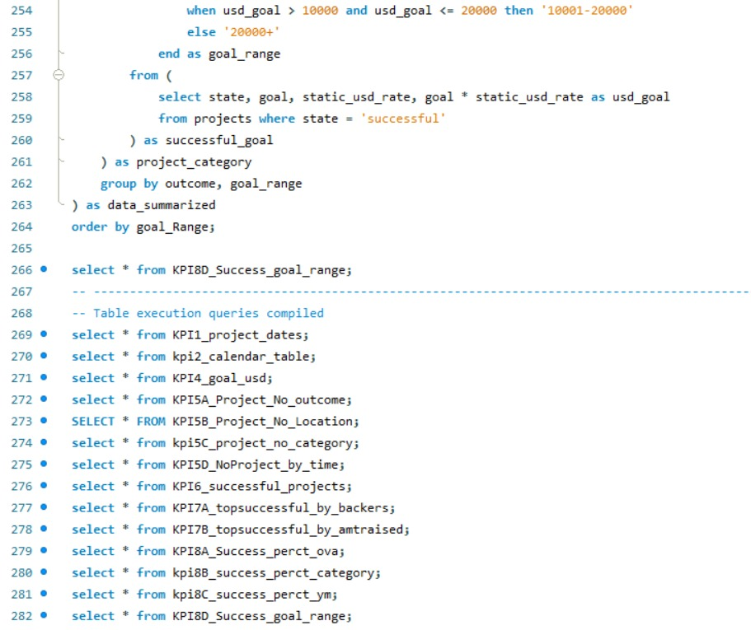
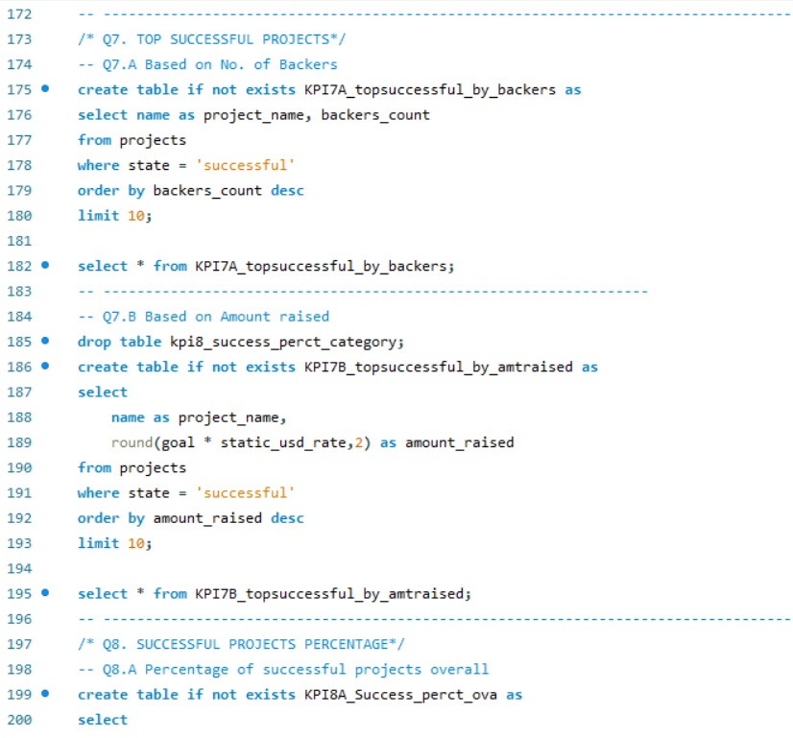
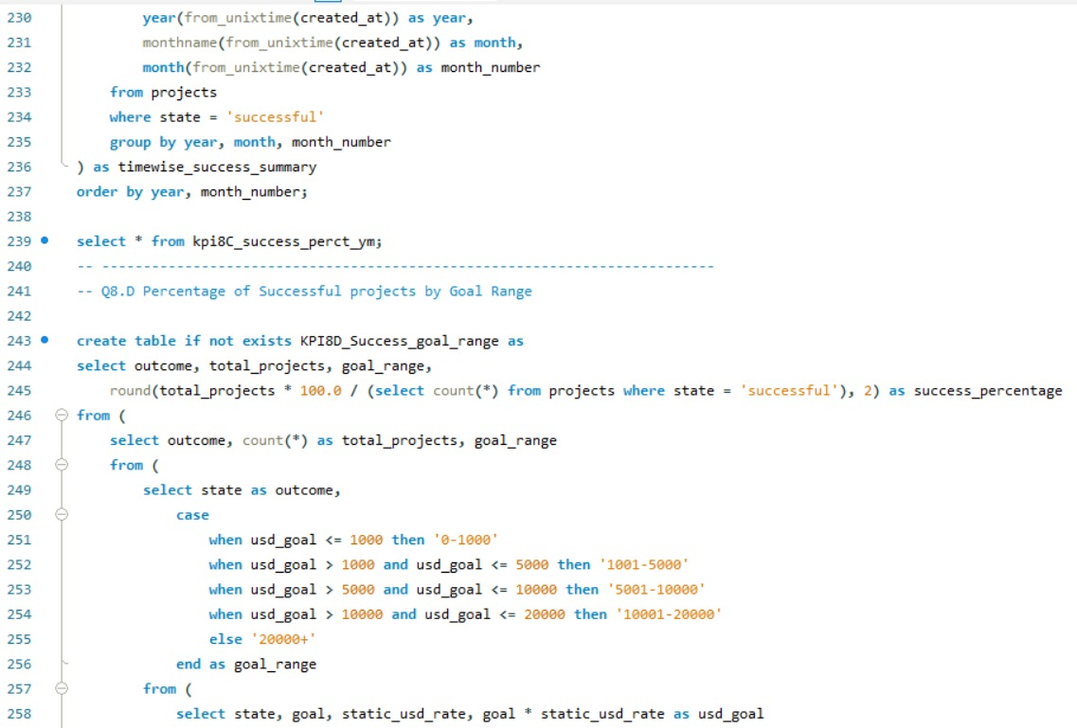
SQL QUERIES

Slide 27
CONCLUSIONS
1
REALISTIC TARGETS ARE THE KEY
2
DURATION IMPACTS RESULTS
3
LAUNCHING AT A RIGHT TIME MAXIMIZES THE CHANCES OF SUCCESS
4
WITH PROPER MARKETING AND GLOBAL EXPANSION WE CAN CATER MORE NO. OF USERS
THANK YOU

Slide 28
THANK YOU

